Slide 1
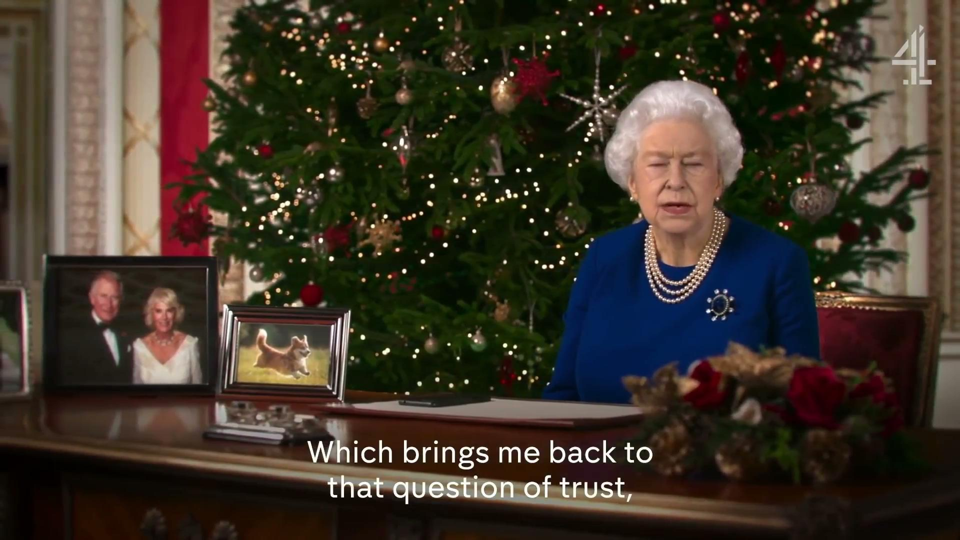

Slide 2
DEEPFAKE
Fake or real
Members:

Slide 3
Outline WHW
Introduction: What is Deepfake
(Video ngắn: Donal Trump là thành viên của chúng ta, giới thiệu Deepfake lịch sử) PMN
Thuật toán: How to build
(Cnn (HTH), GAN(TTMH))
Application: Which it bring to us
Deepfake mang lại điều gì cho chúng ta(TNQ)
Conclusion

Slide 4


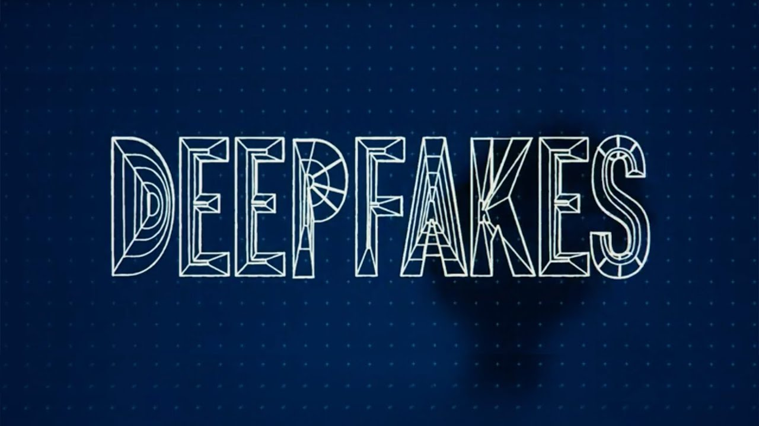

Slide 5

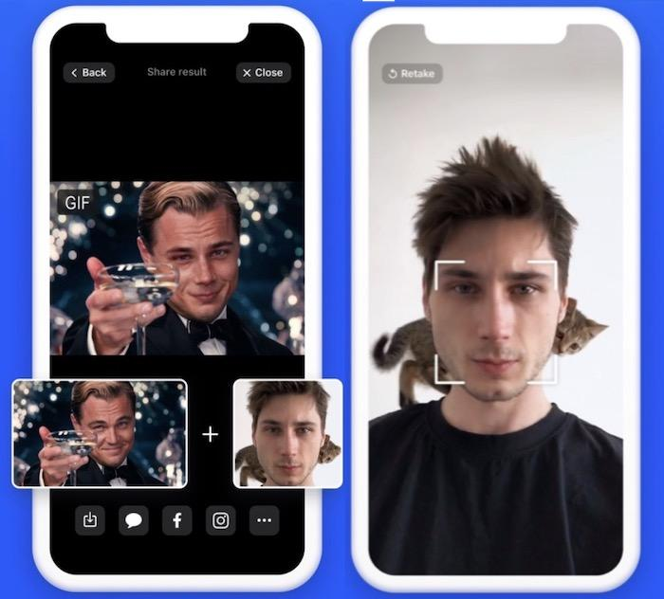

Slide 6



Slide 7
Algorithm
CNN

Slide 8
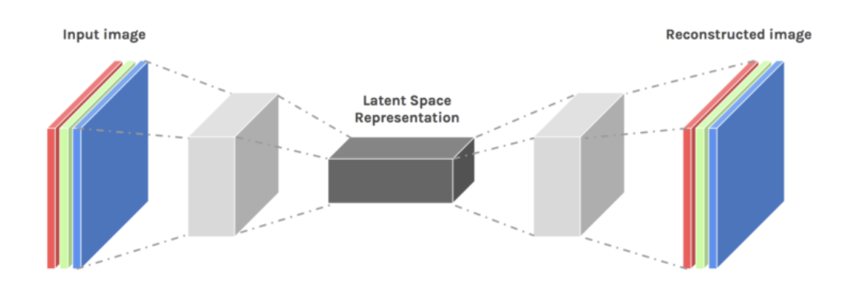
Auto-encoder
Unsupervised machine learning algorithm
Setting the target values to be equal to the inputs

Slide 9
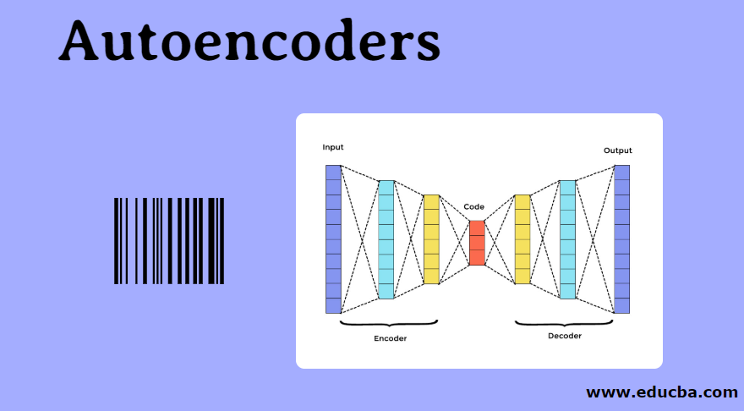
Auto-encoders’ Applications

Slide 10
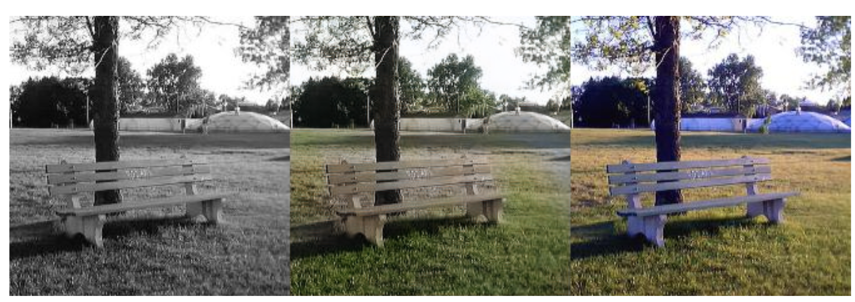
Image Coloring
Convert any black and white picture into a colored image.
Depending on what is in the picture, it is possible to tell what the color should be.

Slide 11
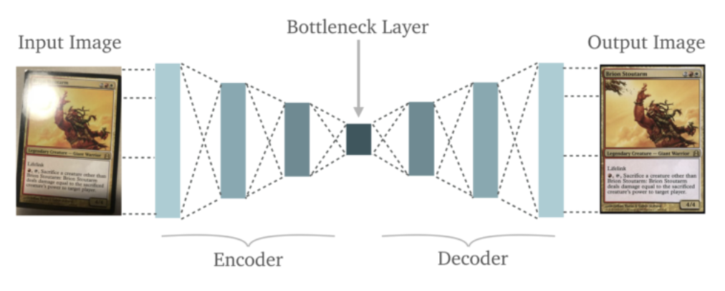
Feature Variation
It extracts only the required features of an image and generates the output by removing any noise or unnecessary interruption.

Slide 12
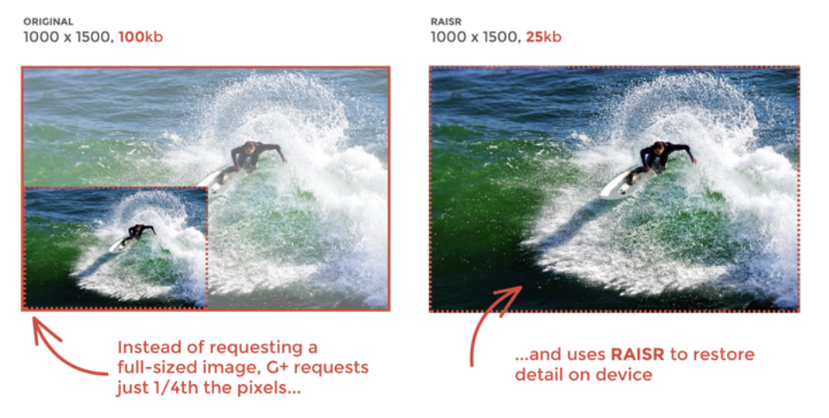
Dimensionality Reduction
The reconstructed image is the same as our input but with reduced dimensions. It helps in providing the similar image with a reduced pixel value.

Slide 13
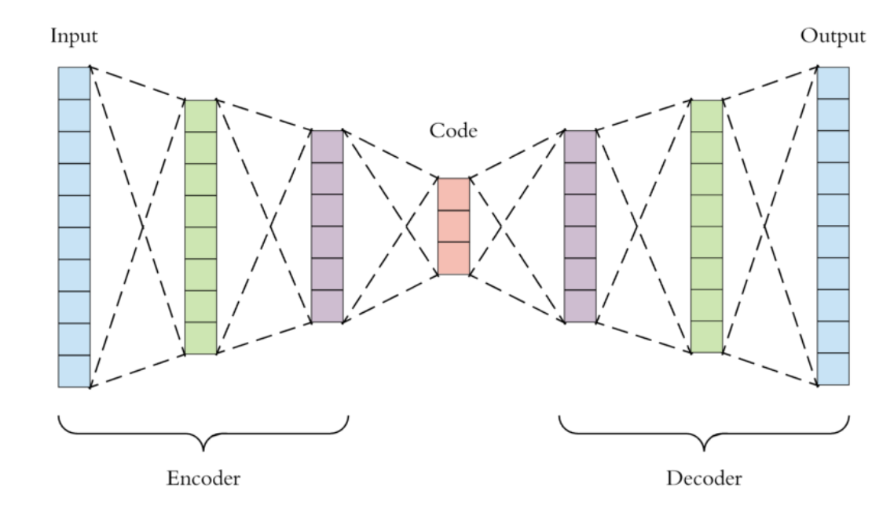
Architecture of Auto-encoders
Encoder: This part of the network compress the input into a latent space representation.
Code: This part of the network represents the compressed input which is fed to the decoder.
Decoder: This layer decodes the encoded image back to the original dimension. The decoded image is a lossy reconstruction of the original image and it is reconstructed from the latent space representation.

Slide 14
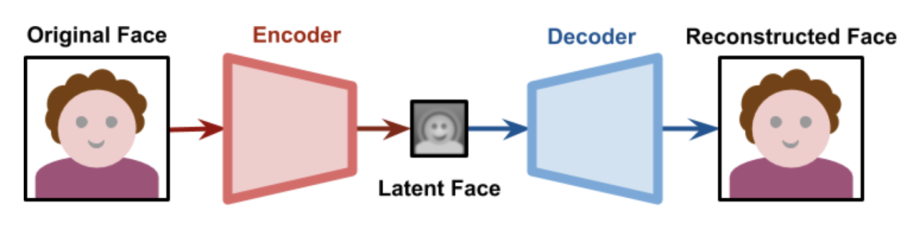
Auto-encoders in Deepfakes
Auto-encoder which is used for encoding the input image by applying dimension reduction and image compression.
Its result is a lower dimensional representation of that very same face
When passed through a decoder, the latent face is then reconstructed

Slide 15
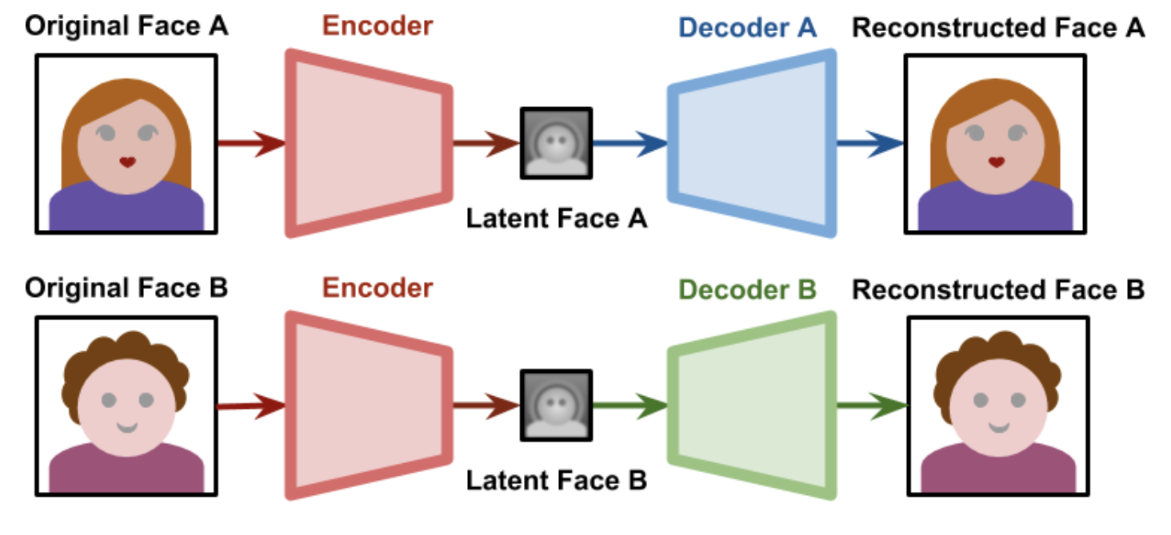
Training Deepfakes
Face swapping technology possible is finding a way to force both latent faces to be encoded on the same features. Deepfakes solved this by having both networks sharing the same encoder, yet using two different decoders.

Slide 16
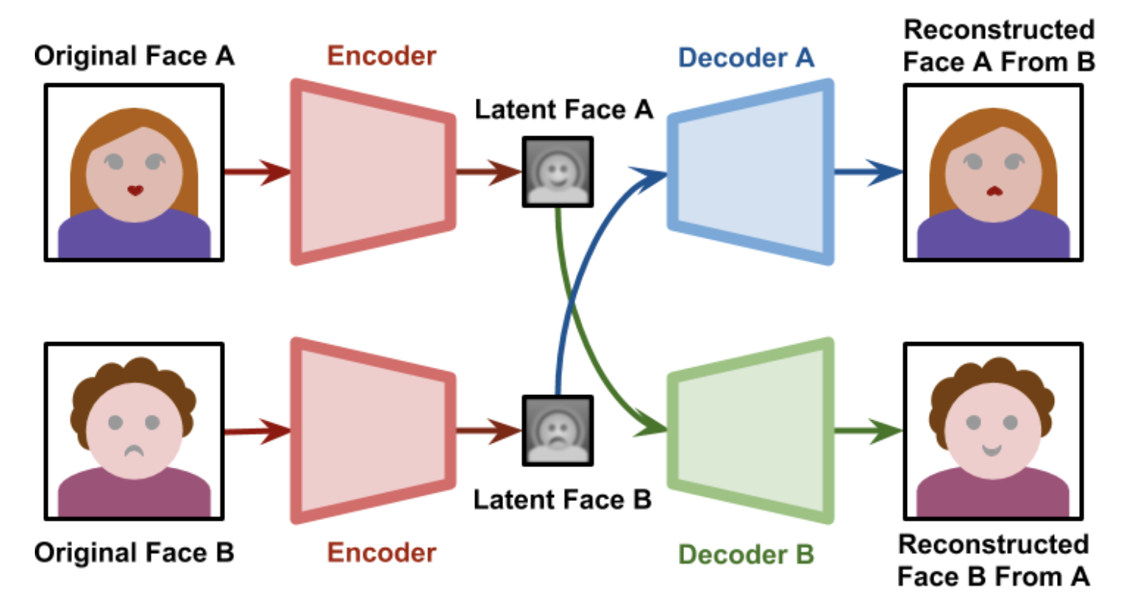
Generating Deepfakes
When the training process is complete, we can pass a latent face generated from Subject A to the Decoder B. As seen in the diagram below, the Decoder B will try to reconstruct Subject B, from the information relative to Subject A.

Slide 17
Generative adversarial networks (GANs)
GANs are generative models: they create new data instances that resemble your training data.
For example, GANs can create images that look like photographs of human faces, even though the faces don't belong to any real person.

Slide 18
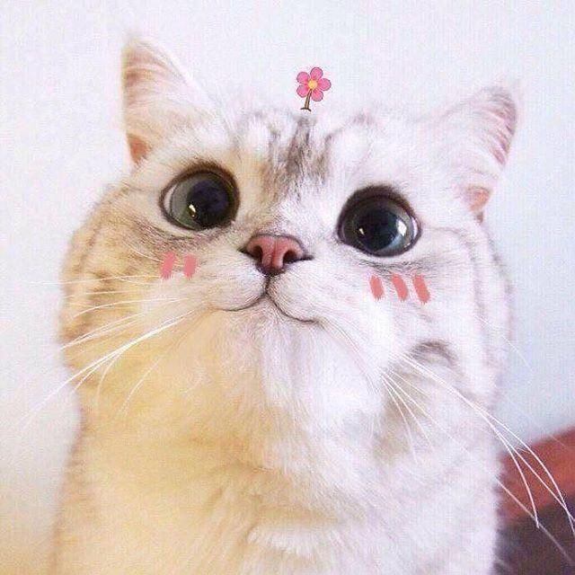
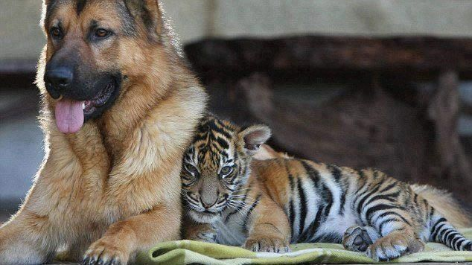
Background: Generative Model?
Generative models can generate new data instances.
Discriminative models discriminate between different kinds of data instances.
Notes:
? Tạo ra loại mô hình nào sẽ khó hơn? Đáp án là Generative Model vì nó phải ghi lại nhiều mối tương quan hơn. Discriminative Model chỉ chú ý vào vài đặc điểm phân loại và không quan tâm đến các mối tương quan

Slide 19
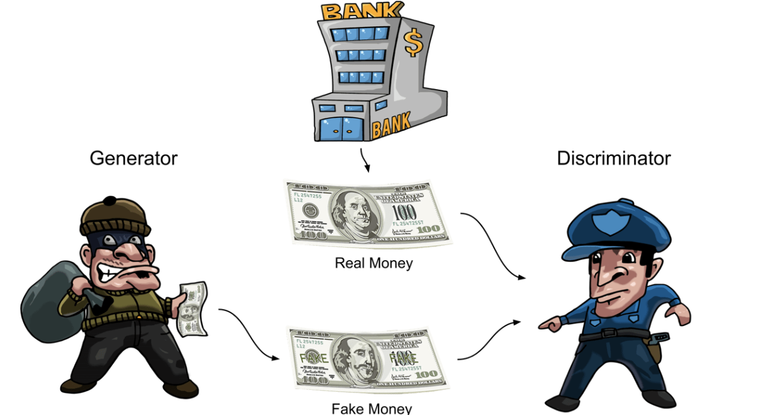
GAN Structure
The generator learns to generate plausible data. The generated instances become negative training examples for the discriminator.
The discriminator learns to distinguish the generator's fake data from real data. The discriminator penalizes the generator for producing implausible results.

Slide 20
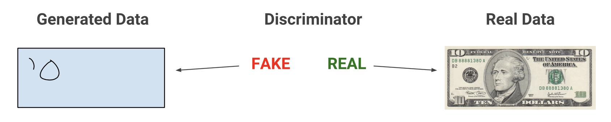
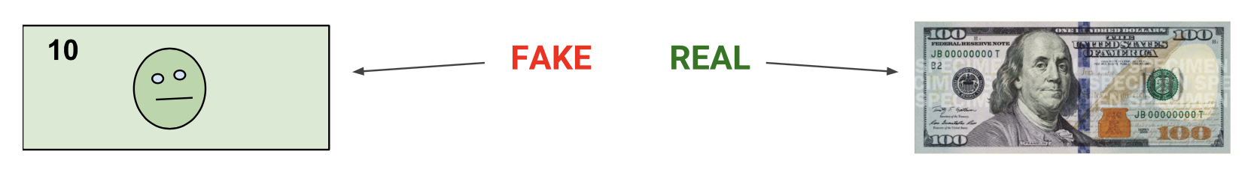
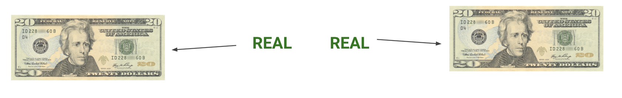
Activity

Slide 21
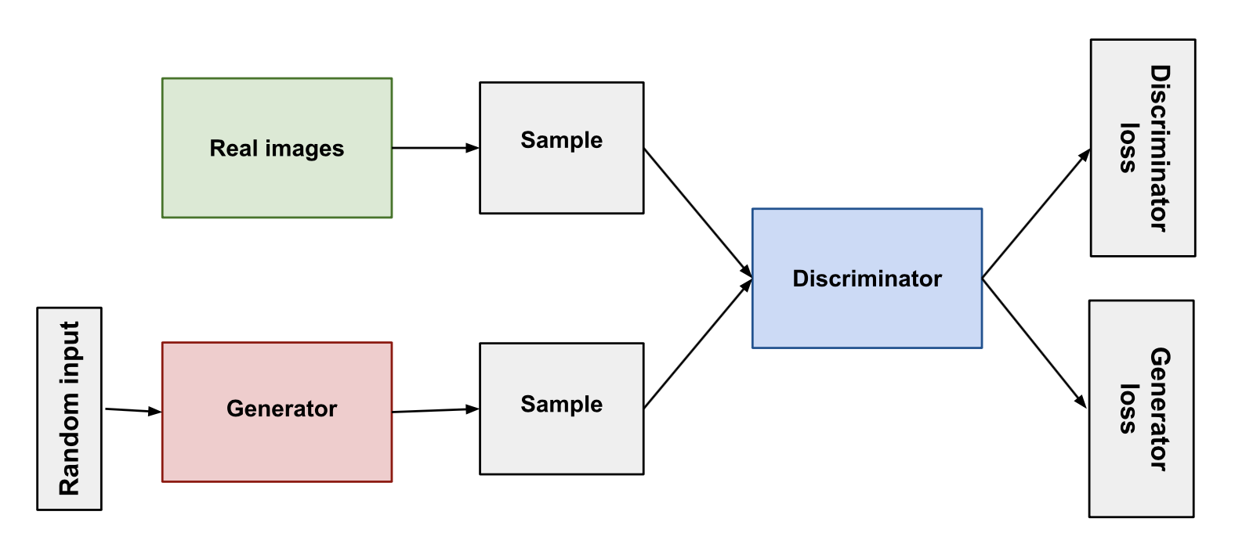
Whole system structure
Notes:
Both the generator and the discriminator are neural networks. The generator output is connected directly to the discriminator input. Through backpropagation, the discriminator's classification provides a signal that the generator uses to update its weights.

Slide 22
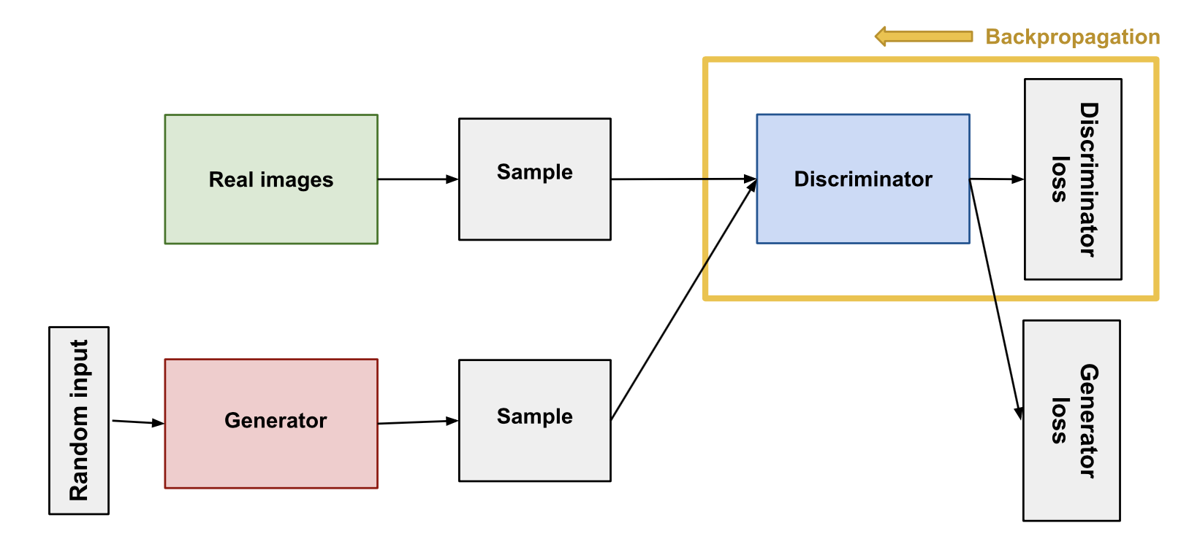
Discriminator
Simply a classifier tries to distinguish real data from the data created by the generator.
Training Data: Real data and fake data

Slide 23
Discriminator
During discriminator training, the discriminator ignores the generator loss and just uses the discriminator loss.
The discriminator classifies both real data and fake data from the generator.
The discriminator loss penalizes the discriminator for misclassifying a real instance as fake or a fake instance as real.
The discriminator updates its weights through backpropagation from the discriminator loss through the discriminator network.
Notes:
We use the generator loss during generator training

Slide 24
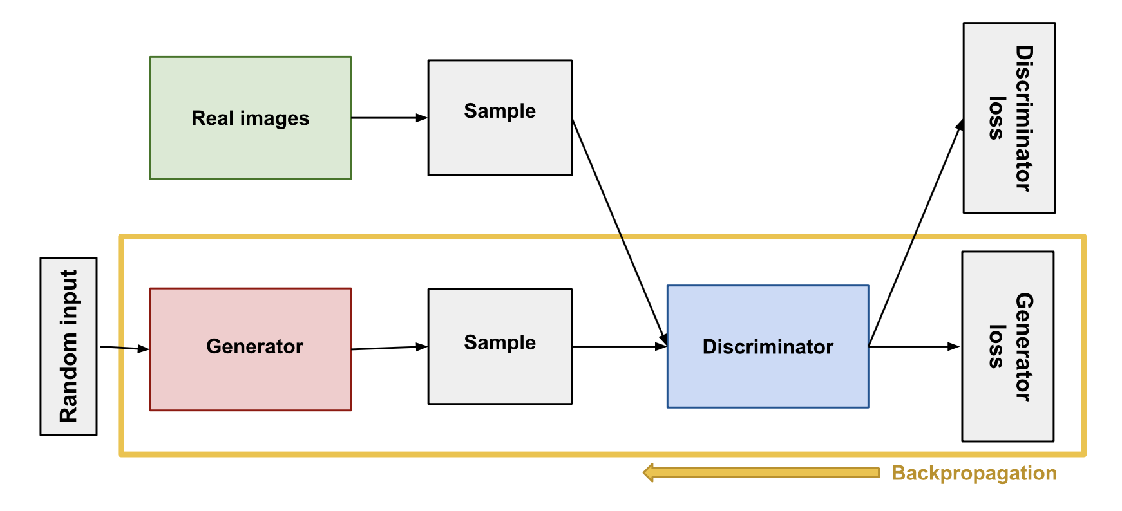
Generator
The generator part of a GAN learns to create fake data by incorporating feedback from the discriminator. It learns to make the discriminator classify its output as real.
Generator training requires tighter integration between the generator and the discriminator than discriminator training requires.
Notes:
We use the generator loss during generator training

Slide 25
Generator
Sample random noise.
Produce generator output from sampled random noise.
Get discriminator "Real" or "Fake" classification for generator output.
Calculate loss from discriminator classification.
Backpropagate through both the discriminator and generator to obtain gradients.
Use gradients to change only the generator weights.
Notes:
We use the generator loss during generator training

Slide 26
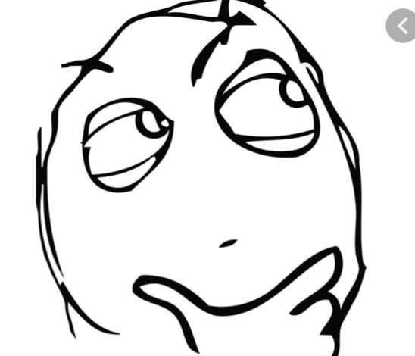
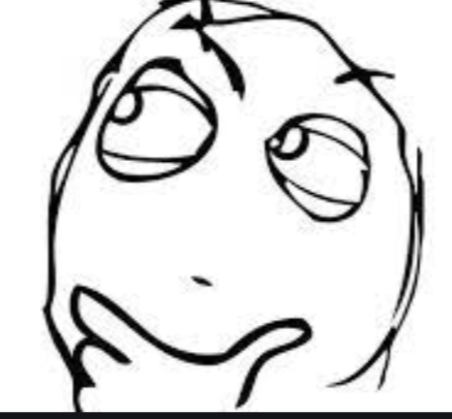
GAN Training Problem
GANs must juggle two different kinds of training (generator and discriminator)?
GAN convergence is hard to identify.

Slide 27
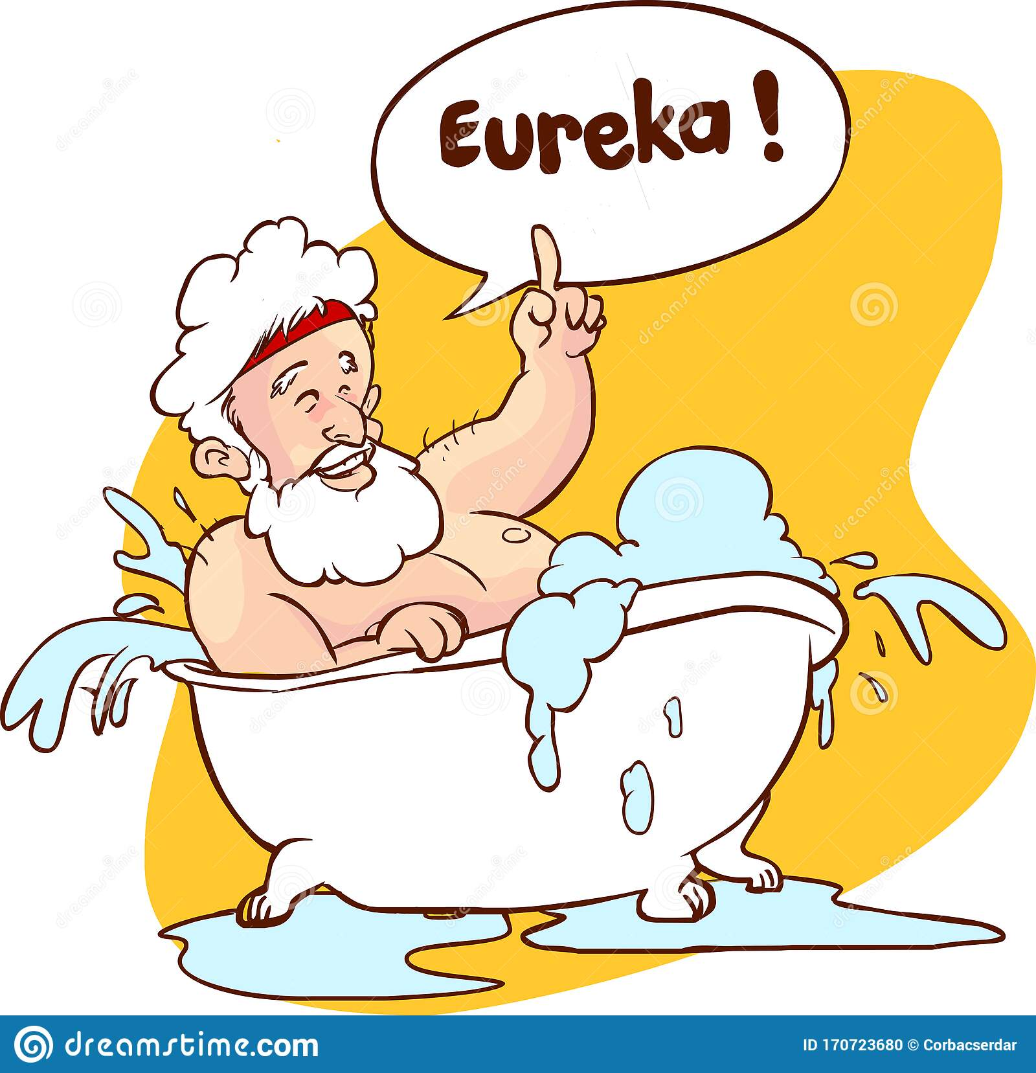
Alternating Training
The discriminator trains for one or more epochs.
The generator trains for one or more epochs.
Repeat steps 1 and 2 to continue to train the generator and discriminator networks.

Slide 28
Convergence
Nash equilibrium
Notes:
If the generator succeeds perfectly, then the discriminator has a 50% accuracy. In effect, the discriminator flips a coin to make its prediction.
This progression poses a problem for convergence of the GAN as a whole: the discriminator feedback gets less meaningful over time. If the GAN continues training past the point when the discriminator is giving completely random feedback, then the generator starts to train on junk feedback, and its own quality may collapse.
For a GAN, convergence is often a fleeting, rather than stable, state.

Slide 29
GANN in Deepfakes

Slide 30
Compare 2 algorithm

Slide 31
Application
Positive side
Negative side

Slide 32
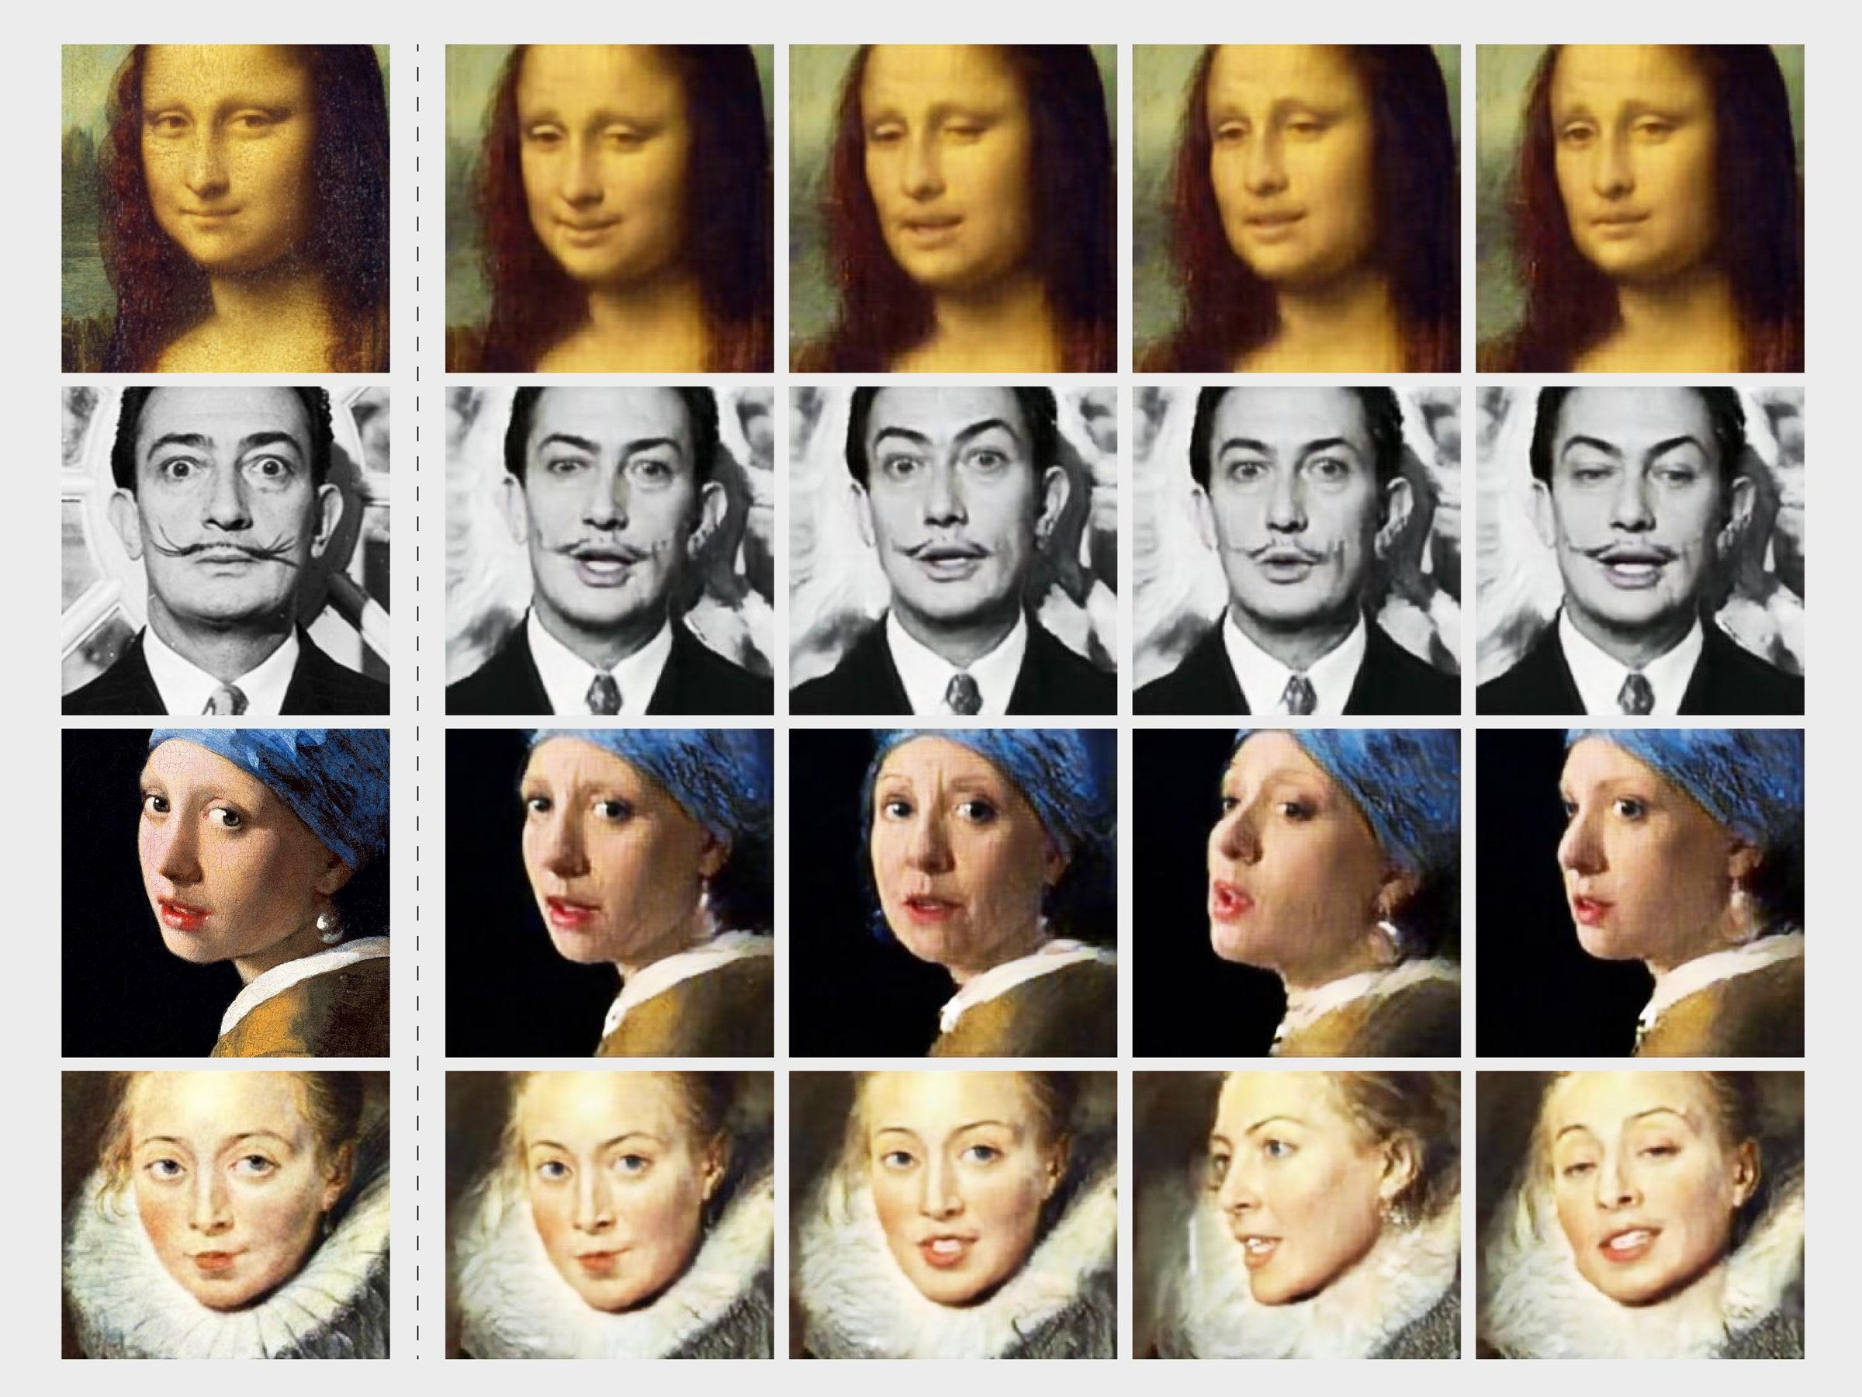

Slide 33
Positive side of Deepfake
Emotion
Finance profits
model nổi tiếng có nhiều hợp đồng và muốn quảng bá nhiều hơn qua nhiều hình ảnh đa dạng …. quá bận
còn giups ích cho doanh nghiệp giảm chi phí sản phẩm
có trợ lí cho kiểu trợ lí sanr phẩm (ví dụ cho các ctrinhf dự báo thời tiết )
kiểu có thể sử dụng hình ảnh tạo ra cho siri
kiểu thay thế mặt nhân vật trong một bộ phim

Slide 34
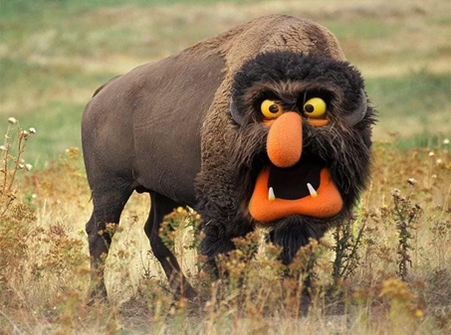
Positive side of Deepfake
Emotional benefits
Bring happy moment, release stress
Bring valuable meaning

Slide 35
Positive side of Deepfake
benefits
Bring happy moment, release stress
Bring valuable meaning

Slide 37
•Scandal
•Misleading and agitation information
•Privacy hazards

